Slide 1
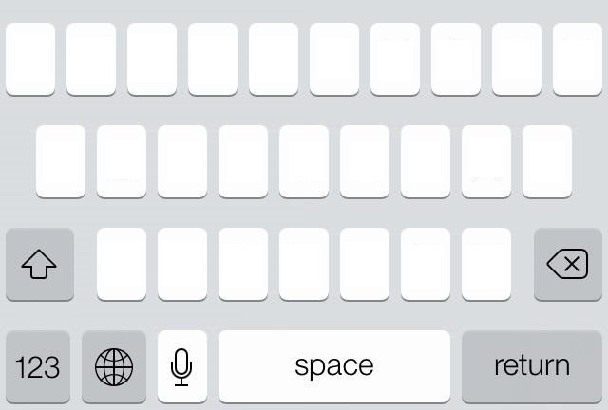
Branch and Bound, Example: Keyboard optimization
S

Slide 2
S
x_{a,1} = 1
x_{a,1} = 0
S₁
S₂
a
a

Slide 3
S
x_{a,1} = 1
x_{a,1} = 0
S₁
S₂
Pruning by infeasibility
x_{b,1} = 1
x_{b,1} = 0
S₁₁
S₁₂
b
b
a
a

Slide 4
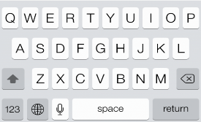
Best solution:
30 ≤ S ≤ 60
ub = 60 wpm
S
Solving the LP:
upper bound = 50 wpm
x_{a,1} = 1
x_{a,1} = 0
lb = 30 wpm
Solving the LP:
upper bound = 60 wpm
S₁
S₂
x_{b,1} = 1
x_{b,1} = 0
S₁₁
S₁₂
…
30 wpm
L
Notes:
Now let’s assume we already have an upper and lower bound. For example by solving the linear programming problem and computing the value of random solution.

Slide 5
Best solution:
30 ≤ S ≤ 60
ub = 60 wpm
S
x_{a,1} = 1
x_{a,1} = 0
lb = 30 wpm
S₁
S₂
x_{b,1} = 1
x_{b,1} = 0
S₁₁
S₁₂
…
Solving the LP:
upper bound = 28 wpm
Pruning by bound
L
Notes:
Now let’s assume we already have an upper and lower bound. For example by solving the linear programming problem and computing the value of random solution.

Slide 6
Best solution:
30 ≤ S ≤ 60
ub = 60 wpm
S
x_{a,1} = 1
x_{a,1} = 0
lb = 30 wpm
S₁
S₂
x_{b,1} = 1
x_{b,1} = 0
S₁₁
S₁₂
…
L
Notes:
Now let’s assume we already have an upper and lower bound. For example by solving the linear programming problem and computing the value of random solution.

Slide 7
Best solution:
30 ≤ S ≤ 58
ub = 60 wpm
ub = 58 wpm
S
x_{a,1} = 1
x_{a,1} = 0
lb = 30 wpm
S₁
S₂
x_{b,1} = 1
x_{b,1} = 0
x_{b,1} = 1
S₁₁
S₁₂
S₂₁
…
Solving the LP:
ub= 58 wpm
30 wpm
Updating the primal bound
L
Computational Interaction Summer School - 6
Notes:
Now let’s assume we already have an upper and lower bound. For example by solving the linear programming problem and computing the value of random solution.

Slide 8
Best solution:
30 ≤ S ≤ 58
ub = 58 wpm
S
x_{a,1} = 1
x_{a,1} = 0
lb = 30 wpm
S₁
S₂
x_{b,1} = 1
x_{b,1} = 0
x_{b,1} = 1
S₁₁
S₁₂
S₂₁
…
ub = 35 wpm
ub = 58 wpm
30 wpm
S₂₁₁
S₂₁₂
L
lb = 35 wpm
Pruning by optimality
… and so on
Computational Interaction Summer School - 8
Notes:
Now let’s assume we already have an upper and lower bound. For example by solving the linear programming problem and computing the value of random solution.

Slide 9
Best solution:
30 ≤ S ≤ 60
ub = 60 wpm
S
x_{a,1} = 1
x_{a,1} = 0
lb = 30 wpm
ub = 60 wpm
S₁
S₂
x_{b,1} = 1
x_{b,1} = 0
x_{b,1} = 1
ub = 28 wpm
S₁₁
S₁₂
S₂₁
…
Pruning by infeasibility
Pruning by bound
ub = 35 wpm
30 wpm
S₂₁₁
S₂₁₂
L
lb = 35 wpm
Pruning by optimality
Computational Interaction Summer School - 9
Notes:
Now let’s assume we already have an upper and lower bound. For example by solving the linear programming problem and computing the value of random solution.

